Slide 1
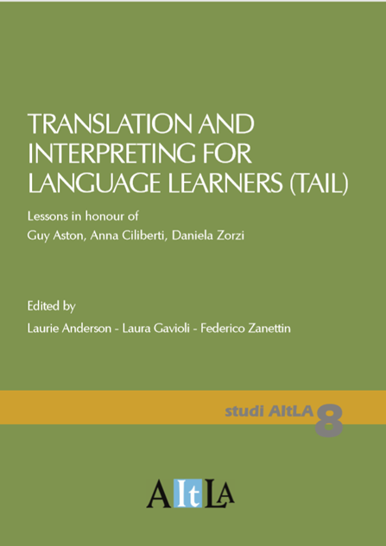
TAIL
A PEDAGOGICAL LEGACY
Notes:
Hello everybody, my task here is basically to introduce my co-editors who have been working at this joint presentation also on my behalf. As some of you know, I’ve had some health issues in the past couple of months, and this is in fact my first public, work-related venture. I’ve been doing very little at home during this time, but Laura and Laurie just would not let me work on this presentation, or rather, they had the slides and everything ready already, always one step ahead as usual.
Before leaving the floor to Laura, I would just like to point out that the word TAIL in the title is not just an acronym for Translation and Interpreting for language learners, but it is also of course a wordplay on the homophones tail/tale, that is, the volume follows from the lessons learnt from Anna, Daniela and Guy, and also tells a story of a long and productive intellectual partnership

Slide 2
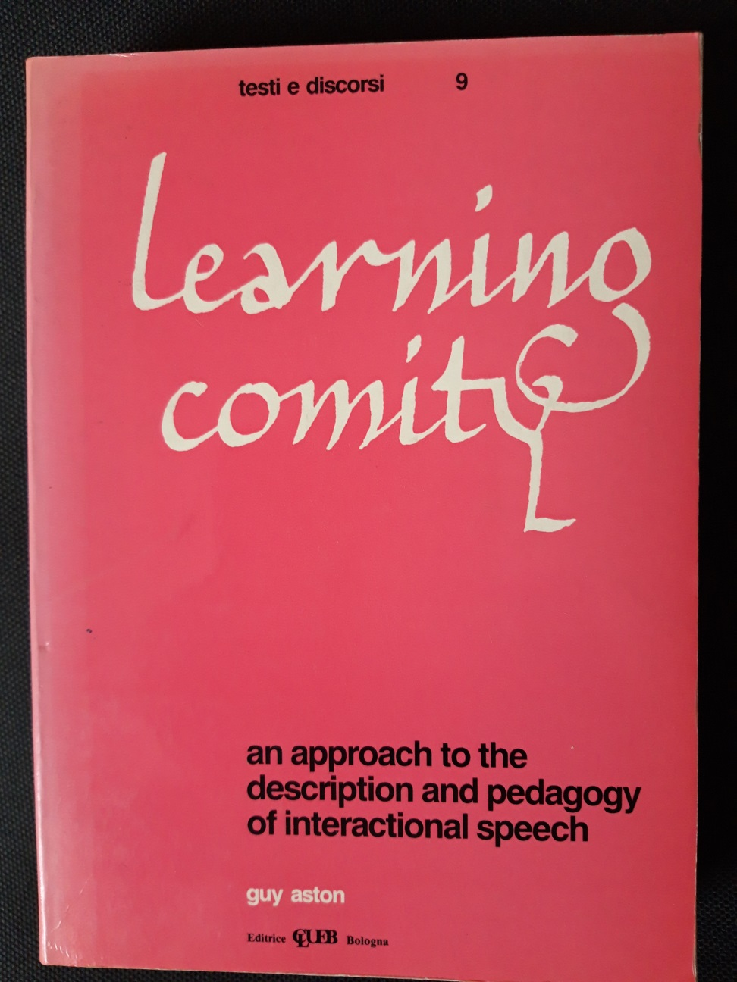
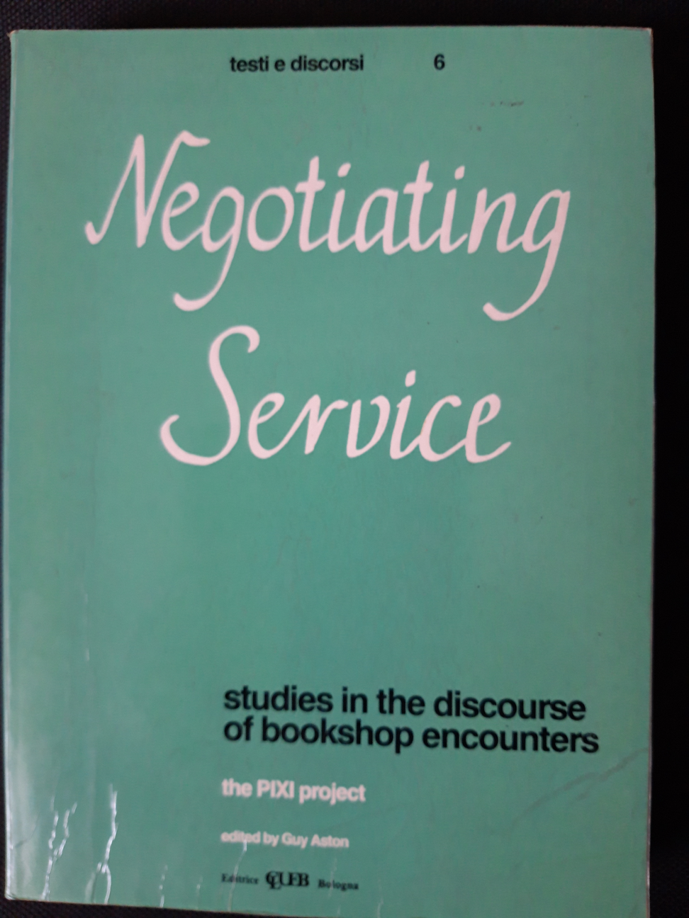
Notes:
In the middle to late 1980s Guy was completing a huge work that was going to become his PhD thesis and eventually a book, Learning Comity [click], published in 1988. During that period, he was coordinating a project financed by the Ministry of Education. It was called PIXI, meaning Pragmatics of English/Italian cross-cultural interaction – the first papers from the project were published in 1988, too [click].
In that period Guy was organizing seminars and workshops for students, inviting expert colleagues from other Universities, Italy and abroad, organizing debates about what were probably the main controversies in applied linguistics of the time
The topics discussed concerned the study of the spoken language, representation of the spoken language through corpora of transcripts, learning and the spoken language, the meaning and significance of interaction (both as an object of study and in language teaching and learning), the integration of the notions of “schema” (the fixed, idiomatic side of language) and system (the componential perspective)

Slide 3
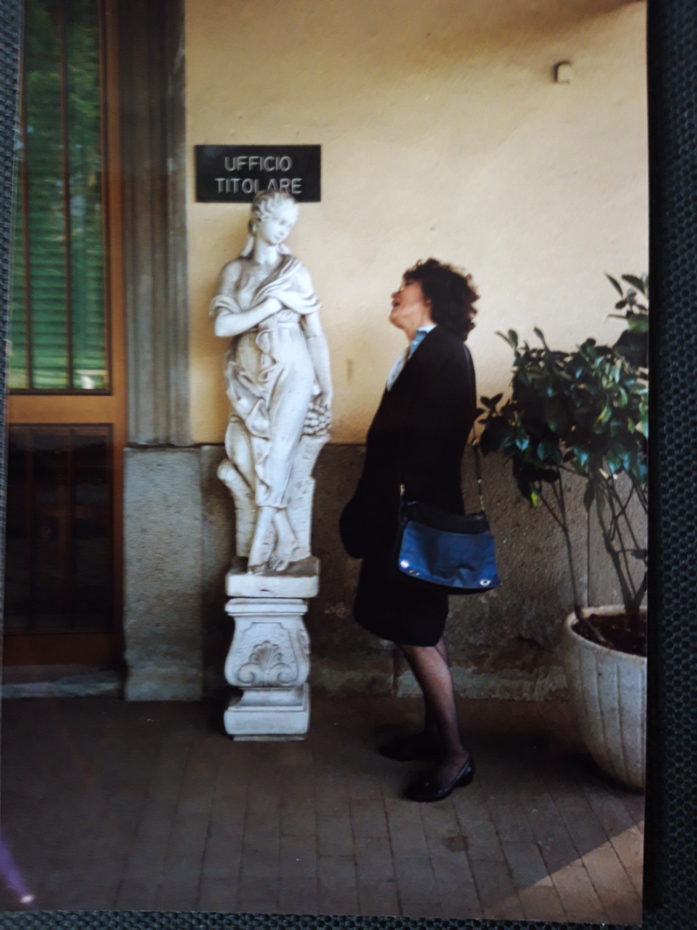
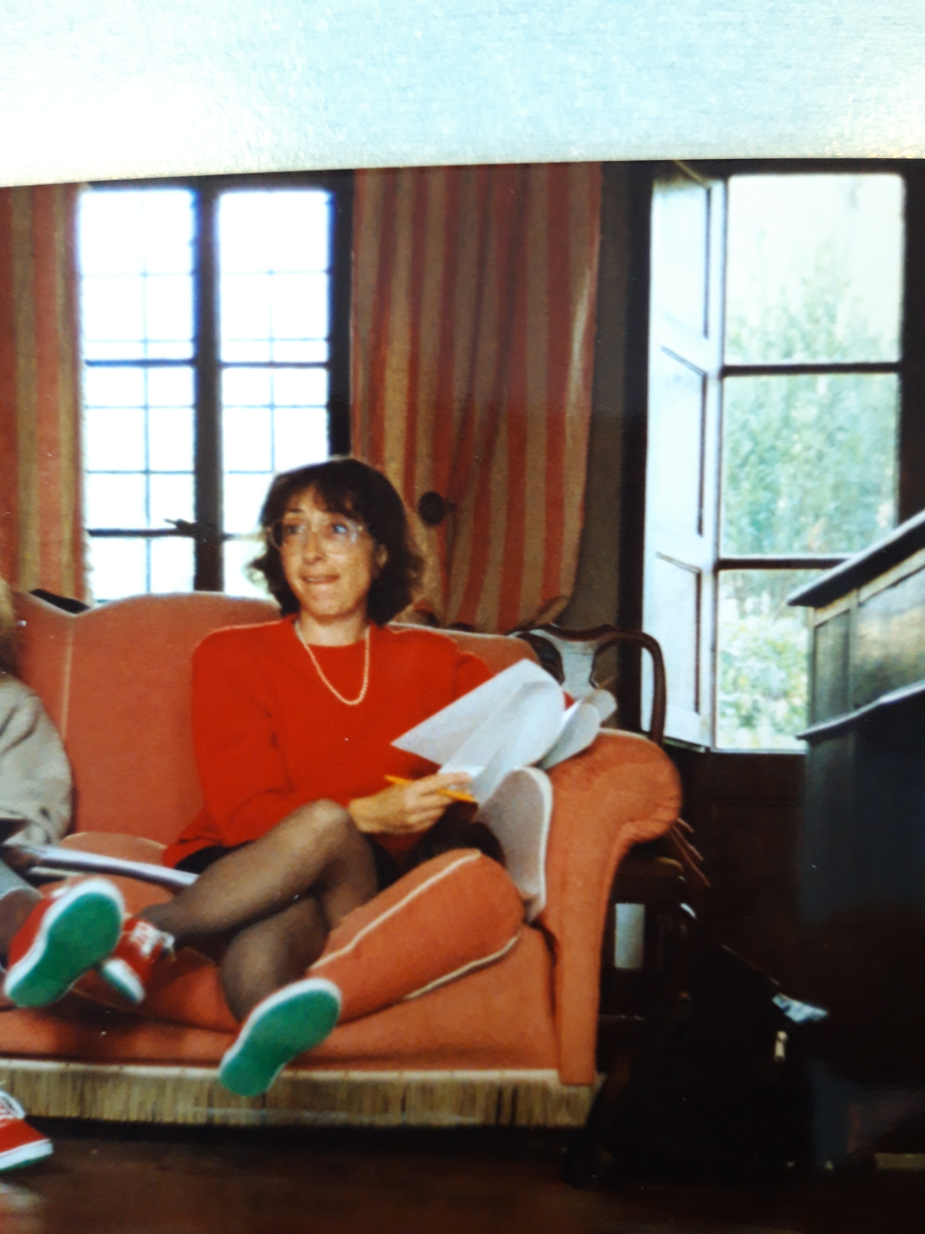
Notes:
During that really fertile period, Guy involved Daniela Zorzi (mainly) and Anna Ciliberti, to put together students who were writing their theses (not necessarily PhD theses) on these topics so as to work and discuss together and with invited, more expert, senior colleagues.
That gave rise to a shared practice or school of thought, a sort of informal "Academy“, in which many students learnt the meaning and significance of “doing research” in language and linguistics (applied linguistics) mutually enriching each other as well as their senior colleagues.
Many of those students have now become senior, many of those senior colleagues have reached top careers and eventually retired, many new, junior students have joined the group, with their projects, ideas and wisdom.
We, juniors and seniors, owe a lot to Guy, who started the process and to Daniela and Anna who supported him with their work and their students. So this book is an obvious way to say thank you to the three of them, Guy first of all.
Getting to it was not easy and we obviously arrived late. None of the three maestros we wanted to say “thank you” to, are here today.

Slide 4
Notes:
But there is something that I have to say. The three of them, all, were strongly critical against those volumes that are known as Festschriften. Their looking down on Festschriften was probably the single point they totally agreed on. So, you see, how can you produce a Festschrift to celebrate someone who doesn’t like festschrift volumes?
So, for a long while we tried to understand what was wrong with festschrifts. What we figured out was that our three friends probably perceived such volumes as “not real thank-yous”, something that you have to do but do not want to really do or possibly a way to dismiss someone nicely.
So we tried to make clear that ours was a real, warm, wholehearted, “longing-for-you-to-stay” tribute to their work with us and for us.
I don’t know if we succeeded, but we tried to do this in four ways.
First, the book is in honour of three, rather than one scholar. Through this choice, we wanted to underline the value of “the group”, of working together as a team. That was the idea of Guy, when launching most of his projects, not only the PIXI, and it was the idea behind Anna, Daniela and Guy’s perspective on teaching and learning, an idea they applied in their own doing research. Gathering efforts, reasoning together on problems, sharing preliminary papers and discussing them, tearing ideas apart through joint discussion and then find new ways of reconstructing them … this is a method of work we have learnt from Anna, Daniela and Guy – a method that Anna, Daniela and Guy used in their own research activity and in their own teaching. So the book pays a tribute to this method.

Slide 5
Notes:
Second, it is a book of “lessons”, not papers. Well, the lessons, as you can read them, are in the form of papers, and they are papers grounded in theory. But they also offer practical examples aimed to inspire teaching and learning activities. There are three motives guiding this choice.
The first is the obvious one. Anna, Daniela and Guy were applied linguists working in the area of teaching and learning. So lessons, or other types of classroom meetings were one of their fields of interest.
The second is that we wanted a book that could be “used”, concretely, by others who, like us, have groups of learners to deal with for a large part of our lives. Not a souvenir. Doing something “useful” for others characterised Anna’s thought – she was a fighter against social inequalities, for instance. “Feeling useful” prompted Guy and Daniela’s generosity towards their students and colleagues. So a “useful” book was probably appropriate.
The third is that working on lessons gave us the possibility to address a principle that we have learned from Anna, Daniela and Guy. That is, language description and language pedagogy can go hand-in-hand of course, but they need separate sets of thoughts. Better language descriptions can improve language pedagogy but they have to be translated into improved language pedagogy. Descriptions of talk, for instance have renewed the idea of how meaning is constructed in language, including interpreting and rendering meaning when talk involves speakers of different languages in dialogue interpreting. Learning how to participate in talk in a foreign language, or learning how to interpret in conversations, however, is different. Describing what occurs is not enough. It requires opportunities to get engaged, interactively, in both observation (of how it works) and practice. “Reality (of data) does not travel with the text”, as Henry Widdowson, Guy’s PhD advisor and maestro, put it.

Slide 6

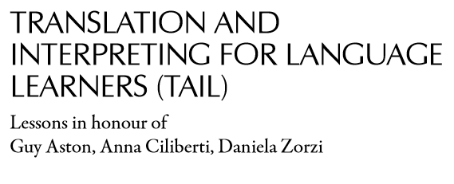
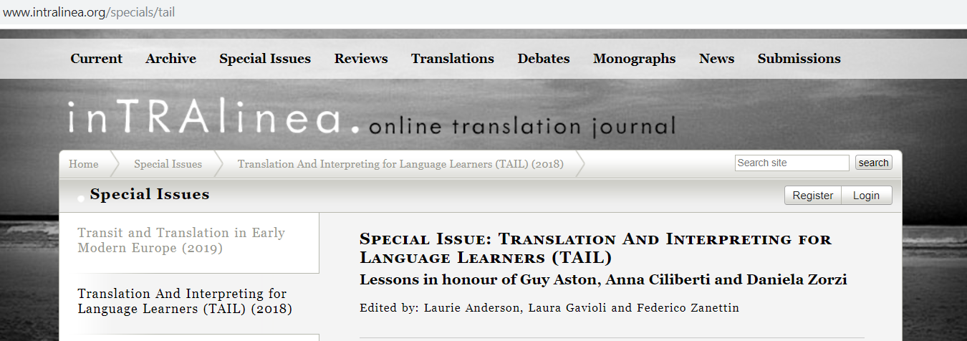
This volume is a joint publication of Studi AItLA and the on-line journal inTRAlinea. It would have never been possible without the precious help and support of the AItLA Board, Anna De Meo, Cristina Bosisio, Elena Nuzzo, Lorenzo Spreafico, and the inTRAlinea editor Chris Rundle. Our warmest thanks go to Carla Bazzanella and Enrica Galazzi, who followed us throughout the editing process with their gentle, punctual and insightful comments and advice.
Notes:
There are two more characteristics that make this volume a “special” tribute. One, the third in the list, is that the volume is published both as a special issue of the online journal inTRAlinea and as a volume in the series Studi AItLA. The inTRAlinea journal was born out of ideas of researchers here, at the DIT department in Forlì, where Daniela and Guy taught, and Studi AItLA is the series of the Italian Association of Applied Linguistics – Anna, Daniela and Guy were among the founders of the association, the AItLA association. It took a while to work out the details and get the joint publication accomplished, but it was finally done – we thank Chris Rundle and the AItLA board full-heartedly for their help with this achievement.

Slide 7
Notes:
Last and not least, TAIL is a book about Translation and Interpreting. None of the three maestros to whom the volume is dedicated was an expert in interpreting, translation or interpreting/translation research.
Not strictly speaking.
However, there is a lot of language learning involved in translation and interpreting (even professional translation and interpreting) and there is a lot of translation and interpreting involved in language learning, as Guy Cook makes clear in his book called Translation in Language Teaching.

Slide 8
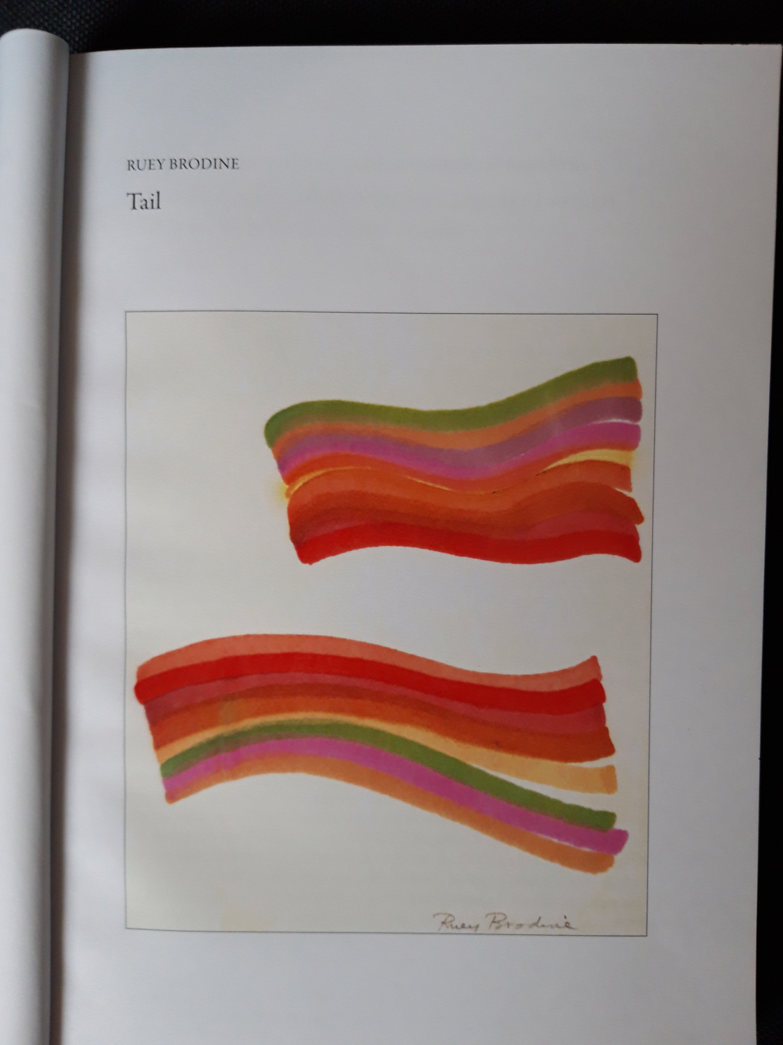
Notes:
In this sense the volume is a TAIL, which is not just the acronym. It is possibly the coda of the ‘X’ in PIXI, cross-cultural. It deals with a range of issues which are inspired to and by the work of Anna, Daniela and Guy, but then developed on their own, as spontaneous, original initiatives of the contributors to the book.
So by way of concluding this premise and then getting to the book contents, “Translation and Interpreting for Language Learners” is a book on Interpreting, Translation and (Foreign) Language learning and the relationships among the three areas. It is book of lessons, developed on the basis of our experience with our students. It is dedicated to Anna, Daniela and Guy because we learnt a lot from them. It is a book which, we hope, will inspire the readers’ teaching, in a learners’ perspective, in areas where a learner-centred perspective is rather new. We hope this is what makes this book a real tribute, a stimulus to carry on those hints and suggestions we received.

Slide 9
Contents
Introduction
Part 1 Interpreting and mediating
Part 2 Corpora and other tools in translation teaching and learning
Part 3 Learning the other’s language and our own
Part 4 Reflections on (cross)language issues
Post-Scriptum Data, learning and cross-cultural interaction: the PIXI project
Aston, Ciliberti, Zorzi: a bibliographical repertoire
Notes:
And now we get to the contents.
As you can see, the volume is divided into 4 parts, two on learning interpreting (the first) and translation (the second). The third is on language learning when students of interpreting and translation are involved. The fourth is on language learning as a cross-cultural and possibly intercultural experience
The post-scriptum collects 4 contributions by former PIXI members and the section as a whole aims to give a taste of what the PIXI project was as an academic and human experience.
A bibliography of Anna, Daniela and Guy closes the volume. What we did here was to group the references under different headings relating to the topics dealt with in the volume so as to make the lines that connect their and our work clearer.
I will introduce Part 1, then leave the floor to Federico and Laurie.

Slide 10
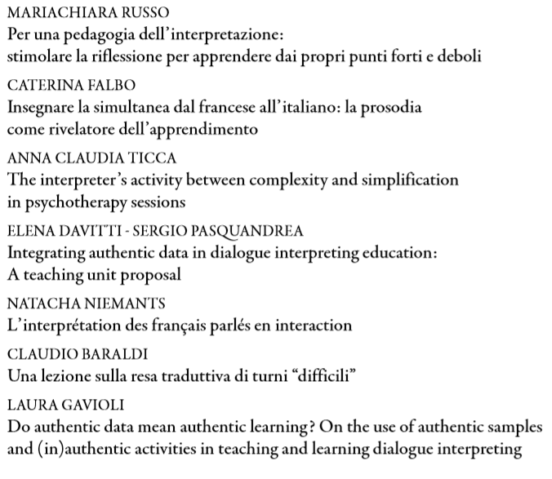
Part 1: Interpreting and mediating
Notes:
The papers you see here are all based on transcripts of audio or video clips. The first two are on conference interpreting, the others deal with dialogue interpreting. They offer reflections on how to integrate observation of authentic transcripts into teaching/learning activities in order to more actively involve students in the learning process. As I mentioned, showing what occurs does not make occurrences learnt. So our attempt here is to suggest activities that give the students opportunities to interact with the data, for instance by comparing their production to that of interpreters in the data, not necessarily professional interpreters.
The papers contain reflections on evaluation, for instance by putting students’ evaluation in their own hands. This is shown in Mariachiara’s paper for instance. Caterina also suggests that students can be given opportunities to reflect on the meaning and use of prosody to convey meaning and then evaluate their use of prosody along these lines.
The problem of selecting which data, which sequences and what to look at in the sequences to analyse with the students is posed in Elena and Sergio’s paper, who also suggest that an interesting type of sequence for the students to discuss is the so called «dyadic sequence», when interpreters open side sequences in interaction talking with one paricipant only.
The problem of dyadic sequences is posed in Anna Claudia Ticca’s paper too. Here she looks at therapy sessions with refugees and the problem of rendering the therapist’s questions. She observes that while in other medical settings, intepreters speak with the patients alone briefly, in their language to make the sense of the question clear, this cannot be the case in therapy sessions and here a close collaboration between the therapist and the interpreter needs to be achieved. So her suggestion is that data can be used in professional training so that interpreters and therapist discuss the problems the data reveal from their own perspectives.
Natacha provides suggestions on how to deal with basic interpreting, the abc, like achieving familiarity with spoken monologues, dealing with disagreement and misunderstanding, dealing with the negotiation of understanding, co-construction activities which characterize conversation, even intepreted conversation.
Claudio shows ways to promote discussion and debate about interpreters’ renditions of «difficult» turns, for instance in delicate situations. He analyses transcripts of his own debates with students during the lessons (lessons he recorded) to see what works and what doesn’t.
I reflect on roleplays. In particular, I look at what may be spontaneous interpreter responses in talk that is «not spontaneaous». For instance, the students who play the role of interpreters in talk need to do some turn coordination work and what and how they render in talk sequences is not always expected, so there is some meaning negotiation even in roleplays – or in particular types of roleplays.

Slide 11
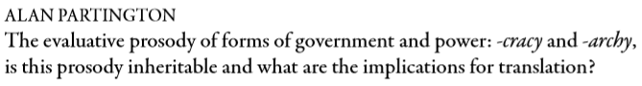
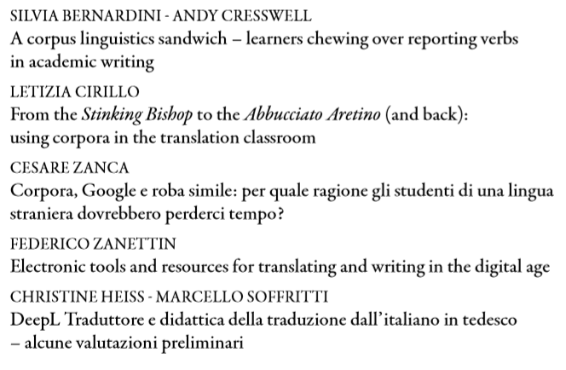
Part 2: Corpora and other tools in translation teaching and learning
Notes:
The second part of the volume deals with a topic to which Guy devoted quite some time in his academic career, i.e. corpora. Let’s not forget that what got Guy started on corpora was the creation of a computerized version of PIXI’s transcripts, but on Pixi again Laura & Laurie will say something soon.
The essays included in this section are also all based on actual lessons or courses, but take somewhat different angles. Thus, Alan’s essay shows how to guide students to explore descriptive features of language, and how queries based on morphological features, namely the English suffixes -cracy and -archy, may be exploited in order to find out about language productivity. Alan’s chapter grew out of some notes he had taken in the early 90s here at what was the SSLMIT, showing how data-based teaching can feed into research, and was subsequently expanded with the help of large newspaper corpora. Alan provides convincing examples to exemplify evaluative prosodies of lexical items, and suggests that a cross-lingual comparison of words and expressions which are commonly perceived to have similar semantic prosodies may in fact be a very valuable activity for language learners and translators alike, and one in which the help of corpora is indeed invaluable.
Silvia and Andy’s article focuses on a study of citations expressed through projecting clauses, and involved first classifying and describing concordances from a corpus of academic English, then comparing findings from this corpus with those from a corpus of English as a lingua franca. This was part of both a language course and a linguistics course, and that’s the reason of the title “A corpus linguistics sandwich”, and of the food metaphor which runs throughout the article, which I’m sure Guy quite enjoyed when he saw it. And it is, of course, also remindful of Nathalie Kubler’s speech of this morning.
Letizia Cirillo illustrates a module designed to provide students with hands-on experience of corpus aided translation, and a series of activities leading to the students designing and compiling their own specialised comparable corpora from the Web. Like in Silvia and Andy’s article (and, I could add, possibly in all the articles in the volume) one paramount objective of this essay is to increase the students’ metalinguistic awareness and learning autonomy.
The next two articles, by Cesare Zanca and myself, are quite similar in that they both deal with the use of language corpora and online resources such as search engines and dictionaries to help students translate as well as read and write in a foreign language. They are also similar in that they both describe activities carried out with language learners rather than primarily translation students. More in particular, Cesare provides a rather comprehensive overview of online language resources and of how they can be used by students, while I provide a step by step illustration of how a group of students I worked with used this type of resources to carry out translations and write summaries.
Like these two, the last article in the second part of the volume, by Christine Heiss and Marcello Soffritti, also draws attention to how the technological environment has changed since the times when Guy first started to think about pedagogical applications of text corpora. Christine and Marcello discuss DeepL Translate, a recent system based on neural networks, and provide an evaluation of the system’s output relative to different types of technical texts, comparing it to published human translations and to the competing Google Translate system. They argue that, notwithstanding the emergence of more sophisticated machine translation systems and considerable quality improvements, the need for human post-editing is still present, and provide some suggestions about how to incorporate MT output evaluation and post-editing into the training of professional translators.

Slide 12
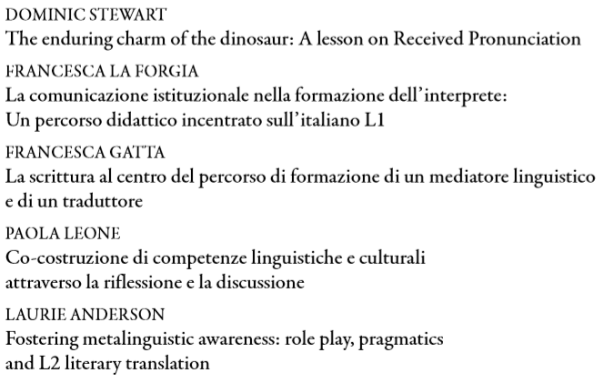
Part 3: Learning the other’s language and our own
Notes:
As Laura mentioned, this third section focuses on the connection between translation and language learning: it contains papers that describe «lessons» and «course designs» aimed both at students who are training to be interpreters and translators and at students for whom translating is part of a general language curriculum.
The papers by Dominic Stewart and myself focus on the learning of English; those by Francesca La Forgia and Francesca Gatta, on Italian as an L1, Paola Leone’s focuses on both Italian and English as an L2. But what struck me most, however, as I was rereading the papers in preparation for today’s presentation, was a common denominator: the focus on teaching/learning activities designed to develop critical awareness and reflective practice.
Dominic Stewart presents a lesson designed to get interpreting trainees and learners of English to reflect critically on why the form of English pronunciation known as RP still constitutes a target for students and teachers of English. It’s a good read, not only because of Dominic’s delightful tongue-in-check style, but also because it proposes practical that help learners realise that that RP is not the monolithic, clearcut model it is often made out to be. One of these involves observing the variable pronunciation of intervocal /t/ in a video interview of a well-known actor.
Francesca La Forgia presents and motivates a teaching model designed to help students of interpretation develop a more pragmatic understanding of what’s involved in institutional communication. One thing that I particularly appreciated in this paper was the strong sense of teaching/learning as a situated activity, both in a curricular sense, with the course of Italian L1 being conceptualized explicitly located at the intersection of the different language combinations, and in terms of the teaching process (the author very clearly highlights how the series of activities build on and make explicit the implicit knowledge students have already obtained from their previous courses). A great example of a truly curricular approach in interpreter education.
As someone who researches academic writing herself, I found the third contribution, by Francesca Gatta, particularly intriguing. She presents and motivates a 20-hour writing seminar that accompanied her 2017 Italian Linguistics course. There’s a lot of food for thought for other teachers in the article, but what I particularly liked was a three-stage activity in which students acquired a stronger sense of the differences between oral and written communication by first transcribing an interview, then recasting it a publishable version (with clear-cut questions and answers) and finally producing a 2-paragraph summary. I’m thinking of borrowing this sequence of activities for my next year’s English linguistics course – thank you, Francesca!
The title of Paola Leone’s paper, “Co-costruzione di competenze linguistiche e culturali attraverso la riflessione e la discussione” underlines the teaching approach she’s forwarding. The paper presents a theoretical framework and practical guidelines for making “Tandem-learning”, often thought of as simply a useful ‘side-activity’, into the “main activity” in a language course. Paola describes a project in which pairs of language students, using Voice-over protocols such as Skype, chatted together for half an hour first in one language, then in the other. These conversations were recorded and then subsequently analysed by the students and teachers.
My own contribution to the volume rounds up this section. Like several of the contributions already described, it also makes metalinguistic awareness as a learning goal. It starts from a failure I encountered in teaching translation from Italian to English , i.e. the difficulties I encountered teaching students to use the correct tenses in translating the so-called “future in the past”. In the paper I describe how I combined different pedagogic strategies – including role play and the use of “fumetti” – to try to help students develop a pragmatically-ground awareness of differences between the English and Italian verb systems.

Slide 13
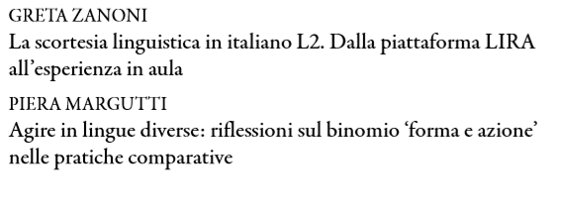
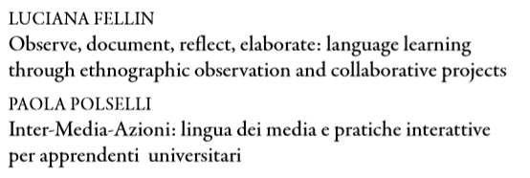
Part 4: Reflections on (cross)language issues
Notes:
Now to the fourth section of the volume. As the title says, the section contains «lessons» and reflections on language pedagogy from a cross-linguistic perspective.
Greta Zazoni shares a hands-on module on «linguistic impoliteness» in Italian L2 that she taught to incoming Erasmus students at the University of Bologna. The unit is called «Offendere, insultare e dire parolacce» – who wouldn’t be attracted by a title like that! But as a fellow teacher I also found several useful pedagogical suggestions in the paper: theoretically, for example, the idea of organising classroom activities explicitly into activities of «noticing and comprehension» and «reflection and understanding». Methodologically, I also appreciated how Greta drew on what we usually think of as a research metodology, the so-called «Discourse completion task», to design a coordinated sequence of classroom activities that also included the use of video.
The subtitle of Piera Margutti’s paper, «Riflessioni sul binomio ‘forma e azione’ nelle pratiche comparative» gives a good sense of its contents. In this contribution, Piera poses a fundamental problem that is central not just to pragmatics as a discipline but also to its application to language pedagogy, i.e. of the extent to which social actions performed in different languages are actually comparable. Drawing on a corpus of telephone invitations recorded in 7 different languages, including Italian, Piera asks students (and readers) to tackle the problem of what we can legitimately compare cross-linguistically. To do so, she draws on various theoretical frameworks, including conversational analysis, Grice’s conversational maxims, and politeness theory.
Luciana Fellin’s contribution draws on her experience in teaching Italian in the US context. As the subtitle indicates, the paper is an invitation to expand how we think of language learning by moving outside of the classroom and engaging students in collaborative groupwork.
The last paper in this section is by Paola Polselli also regards the teaching of Italian as an L2, but like Greta’s, in the Italian context. The paper presents a series of teaching/learning activities that focus on the language of the media and in which the aim, broadly speaking, is to help students appreciate differences in register. Paola proposes a series of group activities that involve different forms of “intralinguistic translation”; as a teacher of another language, I could readily see how some of these could be adapted for groupwork activities in my own classroom. [WAIT TO CLICK]

Slide 14

What do the contributors say about Guy as a friend, teacher, educator?
Notes:
Now we’d like, even if briefly, to – metaphorically speaking – turn the floor over to the contributors to the volume. And also bring our thoughts back to the colleague we are commemorating today. [CLICK]
What do the contributors say about Guy as a friend, teacher and educator? How did rubbing elbows with him influence their approach to teaching? And how do we see what he stood – and fought for – being instantiated in the «lessons» that they share?

Slide 15
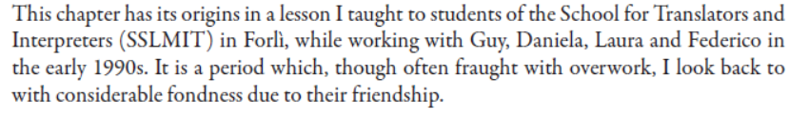

Guy Aston, one of the scholars to whom this collection of essays is dedicated,
speaks Received Pronunciation too, the only trace of his regional origins being the /u:/ he produces with such abandon in the first syllable of the word July. I am pleased to report that this reckless conduct has only marginally affected our friendship, and only in the summer.
Dominic Stewart, p. 262
Alan Partington, p. 151
Gordon Tucker, p. 415
Notes:
If one thing informs all the paper, I think it is a real gratefulness of the friendship and collegiality which characterised the contributors’ interactions with Guy.
There is also an appreciation for how he created conditions for personal and professional growth by leading by example.
Here are just a few of the expression of appreciation in this sense. (PAUSE)

Slide 16
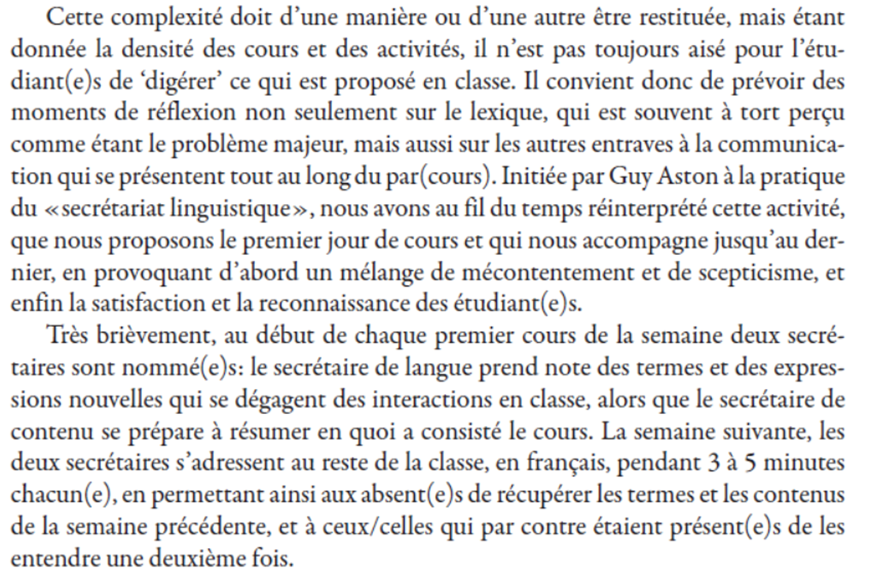
Natacha Niemants, L’interpretation des français parlés en interaction, p. 109
Notes:
In some cases, the debt owed to Guy is expressed more explicit.
In her paper, for example, Natacha describes how she learnt a specific classroom practice from Guy – and subsequently developed it further in her own teaching practice.
«I was introduced by Guy Aston to the practice of «linguistic secretary», which I have reinterpreted over time; I propose it on the first day of the course and it accompanies us until the end, initially provoking a mixture of discontent and scepticism among the students, and by the end of the course satisfaction and recognition of its value.
«The first day of each week «two «secretaries» are nominated: the «language secretary» takes note of the terms and new expressions that arise during class interaction, while the «contents secretary» gets ready to summarize the course contents. The next week, the two secretaries present to the rest of the class, in French for 3-5 mins each, allowing those who were absent to familiarize themselves with the terms and contents from the last week, and those who were present to hear a recap/summary».
What I like about this activity is how it brings together two elements that are essential to achieving effective learning: a collaborative constructivist approach to classroom interaction, and the systematic provision of opportunities for cognitive rielaboration and hence deeper processing, in this case through the task of producing for the benefit an oral summary of a specific aspect – language OR contents – of the lesson from the previous week.

Slide 17
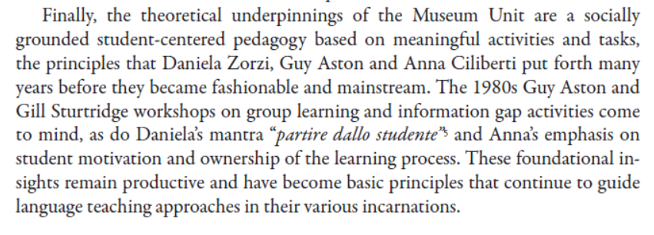
Luciana Fellin, Observe, document, reflect, elaborate: language learning
through ethnographic observation and collaborative projects, p. 383
Notes:
As you’ll recall, Luciana Fellin’s paper describes and motivates a course for L2 learners of Italian centered around the collaborative production of a project. In her paper, Luciana Fellin sums up our collective debt to the «socially grounded student-centered pedagogy» forwarded by Guy, Daniela and Anna in the following terms: «…….»

Slide 18
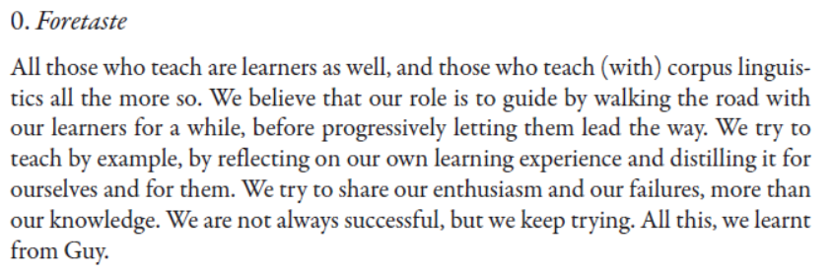
Silvia Bernardini & Andy Cresswell, A corpus linguistics sandwich – learners chewing over reporting verbs in academic writing, p. 165.
Notes:
Another observation about how Guy has been influential in the approach to teaching of many of those who knew him is this one by Silvia Bernardini and Andy Cresswell. [PAUSE] It captures nicely, I think, (1) the continuity between being a learner and a teacher (low power differential), (2) the role of the teacher as an accessible ‘model of how to learn’

Slide 19

What do the «lessons» shared tell us about Guy’s legacy as a teacher/educator?
Notes:
Just a couple more observations about Guy’s legacy as a teacher/educator, this time as it emerges from a reading of the lessons as a whole.

Slide 20
Thinking about university classrooms
High fee, private settings and low fee, state settings
Mono-and multi-cultural settings
‘Soft’ and ‘hard’ disciplines
Reductivist and constructivist
Low and high power distance
Knowledge seen as contested or as given
Inductive and deductive teaching approaches
Individual and collaborative study approaches
«Teaching in the Disciplines» (2019)
Neil McLean, Academic and Professional Development Division
London School of Economics
Notes:
There are many ways of thinking about university classroom; here are several factors that a friend and colleague from LSE shared in a recent workshop I attended. I think they’re useful because they highlight complex interplay that exists between institutional conditions, disciplinary expectations and convinctions about how teaching/learning take place.
As you look at them, consider how they relate to your own experience – as students, and as university teachers
In particular, reflect, based on your contact with Guy’s classroom pratice and his writing on pedagogic issues, on where he would place himself and his «ideal classroom» along the clines indicated in the bottom part of the screen… [PAUSE]

Slide 21
«ascolto consapevole» at the exercise level:
Sensibilizzare gli studenti di interpretazione alla complementarietà fra sintassi e prosodia:
Un esercizio utile per sensibilizzare gli studenti a tali aspetti e far percepire loro in modo analitico le caratteristiche del parlato in situazione di conferenza è bloccare il discorso in un dato punto e chiedere loro quali aspettative abbiano sul seguito non solo a livello di contenuti, ma anche e soprattutto su quali elementi discorsivi potrebbero apparire subito dopo, in base all’analisi prosodica e sintattica effettuata fino a quel momento.
Caterina Falbo, p . 46
Inductive teaching approach
Knowledge as complex /contested
Constructivist
Low power distance
Notes:
I find these clines useful for appreciating how Guy’s legacy is embodied in the contributions to the volumes and would like to offer just one example among many, taken in this case from Caterina Falbo’s «lesson» on teaching simultaneous interpreting from French to Italian.
It’s what Caterina refers to as «ascolto consapevole».
Observe this very simple listening exercise for raising students’ awareness of how syntax and prosody interact in communicating meaning. It embodies the the end-points of the various clines that we would spontaneously associate with Guy: an inductive approach to teaching, a constructivist approach to learning in which knowledge is discussed and co-constructed, a genuine «taking into consideration» of students’ points of view.

Slide 22
«ascolto consapevole» at the lesson level:
Ogni lezione di simultanea prevede infatti tre fasi: una prima fase di introduzione all’argomento che si tratterà, una seconda fase di esercizio in cabina – che viene audio-registrato per ogni singolo studente –, e una terza fase di riascolto del discorso originale abbinato all’ascolto di almeno un’interpretazione effettuata da uno studente. Tutti gli studenti, e in particolare lo studente di cui si sta analizzando e correggendo la prestazione, sono invitati ad analizzare il discorso interpretato non solo dal punto di vista dei contenuti e della formulazione linguistica (accettabilità, adeguatezza) ma anche in base alla fruibilità prosodica del discorso.
…
[L]a discussione con la studentessa ha confermato le ipotesi della docente che ha affrontato l’argomento guidando la studentessa nell’analisi del suo modo di procedere in simultanea. Ne è anche emerso che questo andamento melodico ripetitivo su tutto il discorso, ossia unità intonative con contorni di continuazione seguite da un’unità intonativa pronunciata a velocità di eloquio maggiore rispetto alle parti precedenti, poteva essere dovuto a un décalage troppo breve che non permetteva alla studentessa di agire più sul senso che su ogni singola parola che giungeva al suo orecchio. Un semplice esercizio di allungamento del décalage ha permesso alla studentessa di ascoltare porzioni di discorso sufficienti per consentirle di formulare ipotesi su quale sarebbe stato il seguito dell’enunciato anche sulla base dell’andamento prosodico delle diverse unità informative del discorso originale. Il maggior controllo sul senso di ciò che stava ascoltando e analizzando ha avuto un’influenza positiva e diretta sull’andamento prosodico del discorso interpretato.
Caterina Falbo, p. 54
Notes:
Now let us consider how this «ascolto consapevole» plays out on the lesson level [PAUSE, THEN CLICK]

Slide 23
«ascolto consapevole» at the lesson level:
Ogni lezione di simultanea prevede infatti tre fasi: una prima fase di introduzione all’argomento che si tratterà, una seconda fase di esercizio in cabina – che viene audio-registrato per ogni singolo studente –, e una terza fase di riascolto del discorso originale abbinato all’ascolto di almeno un’interpretazione effettuata da uno studente. Tutti gli studenti, e in particolare lo studente di cui si sta analizzando e correggendo la prestazione, sono invitati ad analizzare il discorso interpretato non solo dal punto di vista dei contenuti e della formulazione linguistica (accettabilità, adeguatezza) ma anche in base alla fruibilità prosodica del discorso.
…
[L]a discussione con la studentessa ha confermato le ipotesi della docente che ha affrontato l’argomento guidando la studentessa nell’analisi del suo modo di procedere in simultanea. Ne è anche emerso che questo andamento melodico ripetitivo su tutto il discorso, ossia unità intonative con contorni di continuazione seguite da un’unità intonativa pronunciata a velocità di eloquio maggiore rispetto alle parti precedenti, poteva essere dovuto a un décalage troppo breve che non permetteva alla studentessa di agire più sul senso che su ogni singola parola che giungeva al suo orecchio. Un semplice esercizio di allungamento del décalage ha permesso alla studentessa di ascoltare porzioni di discorso sufficienti per consentirle di formulare ipotesi su quale sarebbe stato il seguito dell’enunciato anche sulla base dell’andamento prosodico delle diverse unità informative del discorso originale. Il maggior controllo sul senso di ciò che stava ascoltando e analizzando ha avuto un’influenza positiva e diretta sull’andamento prosodico del discorso interpretato.
Caterina Falbo, p. 54
Notes:
On this level as well, esson was constructed following an inductive (data-driven) and collaborative (constructivist) approach. (READ PORTIONS IN RED)

Slide 24
«ascolto consapevole» at the lesson level:
Ogni lezione di simultanea prevede infatti tre fasi: una prima fase di introduzione all’argomento che si tratterà, una seconda fase di esercizio in cabina – che viene audio-registrato per ogni singolo studente –, e una terza fase di riascolto del discorso originale abbinato all’ascolto di almeno un’interpretazione effettuata da uno studente. Tutti gli studenti, e in particolare lo studente di cui si sta analizzando e correggendo la prestazione, sono invitati ad analizzare il discorso interpretato non solo dal punto di vista dei contenuti e della formulazione linguistica (accettabilità, adeguatezza) ma anche in base alla fruibilità prosodica del discorso.
…
[L]a discussione con la studentessa ha confermato le ipotesi della docente che ha affrontato l’argomento guidando la studentessa nell’analisi del suo modo di procedere in simultanea. Ne è anche emerso che questo andamento melodico ripetitivo su tutto il discorso, ossia unità intonative con contorni di continuazione seguite da un’unità intonativa pronunciata a velocità di eloquio maggiore rispetto alle parti precedenti, poteva essere dovuto a un décalage troppo breve che non permetteva alla studentessa di agire più sul senso che su ogni singola parola che giungeva al suo orecchio. Un semplice esercizio di allungamento del décalage ha permesso alla studentessa di ascoltare porzioni di discorso sufficienti per consentirle di formulare ipotesi su quale sarebbe stato il seguito dell’enunciato anche sulla base dell’andamento prosodico delle diverse unità informative del discorso originale. Il maggior controllo sul senso di ciò che stava ascoltando e analizzando ha avuto un’influenza positiva e diretta sull’andamento prosodico del discorso interpretato.
Caterina Falbo, p. 54
Notes:
As far as learning is concerned, it is pursued through a problem-solving approach.
Construction of a hypothesis about a performance difficulty emerged from collaborative analysis by teacher and learner.
Hypothesis: Student was listening to segments of text that were too brief for her to gain access to the speaker’s meaning
Teacher proposed an exercise (allungamento del décalage) designed to modify the learner’s current practice
The learner’s greater awareness led to greater control over her own practice and improved the prosodic control of the interpreted discourse produced.

Slide 25
Riflettere sulla propria ed altrui prassi è per lo studente di interpretazione il miglior esercizio per comprendere il livello di preparazione raggiunto e gli aspetti su cui deve concentrarsi per migliorare.
La ricchezza di spunti e di osservazioni che emerge dalle autovalutazioni degli studenti è anche di grande ispirazione per il docente […]
Fornire agli studenti di interpretazione gli strumenti che consentano loro di sviluppare la necessaria competenza linguistica e comunicativa per essere autonomi e per divenire consapevoli di tale complessità è il mandato pedagogico in cui mi riconosco come docente.
Mariachiara Russo, passim
Inductive teaching approach
Knowledge as complex / contested
Constructivist
Low power distance

Slide 26
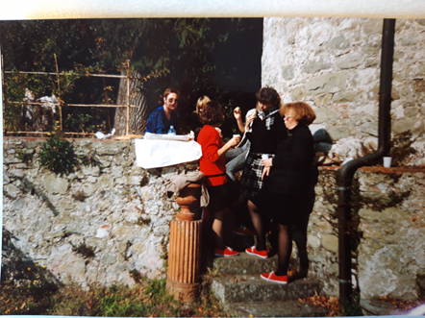
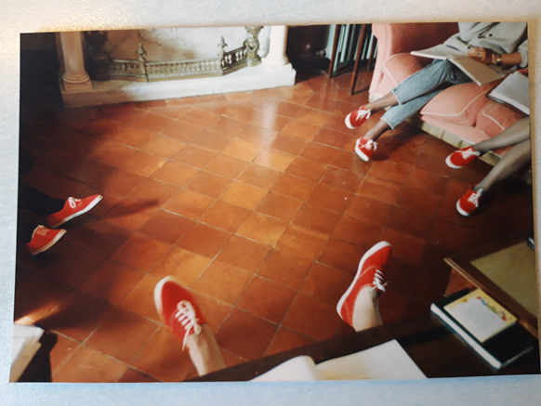
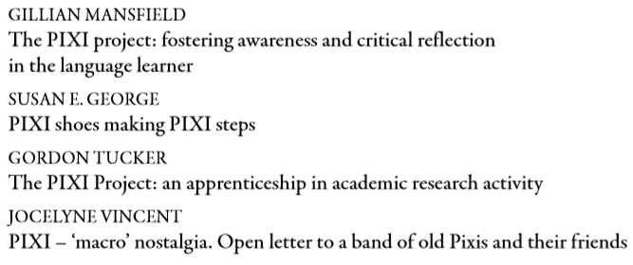
Post-Scriptum Data, learning and cross-cultural interaction: the PIXI project

Slide 27
Over the years […] it has always felt rewarding to be reminded of my collaboration
in the PIXI project, co-ordinated by Guy and with Anna and Daniela prominent
members on the team.
Gillian Mansfield, p. 405
We would have achieved little, though, without the exacting, generous tenacity of Guy Aston who demanded scrupulous data collection and transcription following the norms of conversational analysis while encouraging interpretation from a range of perspectives.
Susan George, p. 409
Despite Guy’s personal preference in the analysis of linguistic phenomena, he
brought together as a team, a group of researchers from differing and contrasting
theoretical paradigms. As a consequence, discussion and interpretation of the service encounter data were not constrained by the theoretical and descriptive precepts of any given paradigm […]. no approach or interpretation was either strongly prioritised or marginalised. […] The result was not only a far richer understanding of the phenomena under attention, but also a greater understanding on the part of individuals in the group of what approaches other than their own preferred approach could bring.
Gordon Tucker, p. 415
Notes:
One thing that pervades these contribution is a sense of privilege, just to having been part of the the PIXI «thing»: as Gill Mansfield puts it, «…….»
There are several common threads in these contributions, but the most salient one is the appreciation for how Guy, as a project coordinator, made space for multiple points of view and interpretative frameworks.
As Sue George puts it, «……..»
Gordon Tucker also highlights the importance of this attitude in fostering discussion and exchange: «…..»
POSSIBLE ADDITIONAL COMMENT: NOT ENOUGH TIME – CUT
This tolerance for other points of view was only one of several aspects that made Guy such a special friend and colleague. Another was how, as Gordon Tucker puts it, beneath an «august and austere» exterior there was a wholehearted belief in research as «interaction among peers» and generosity of spirit.
Gordon Tucker : encounter in Bologna – «what type of articles do you take?» «Good ones»
Other potentially useful comments from PIXI members:
Susan George: «I shall never forget the […]far-sighted determination and generosity of Guy in caring for texts” (p. 413 – ref to helping in preparing her book for publication)
Gordon Tucker : Guy’s decision - an “immense act of generosity” - to send the two of us to present the results of the PIXI project at the 1986 TESOL Annual Convention in Anaheim, California, in Gordon’s words “for me, my very first, exciting transatlantic trip to the USA and to a massive international conference, and for Laurie (and me) the opportunity to stay with her parents in nearby Pasadena. Given that project funding constraints permitted a maximum of two colleagues to travel to California, this was truly an act of generosity and selflessness on Guy’s part, who, as principal investigator, would have been unquestionably entitled to travel himself. (p. 417)

Slide 28
Intellectually, I learnt about the importance of data-based – if not actually
data-driven – research to find out how interaction really works in real settings,
within and across different language/cultures, about the use of authentic naturally occurring interaction data […]
Emotionally and spiritually, I learned about community and love and kindness
and loyalty and honesty among research companions and friends, and I am even
more immensely grateful for those gifts. […]
Jocelyne Vincent, p. 432
Envoi – addressed to ‘young language and communication researchers’:
Your best chance for [offering useful insights for both intercultural understanding and mediation and for second language/culture pedagogy] is to seek out both collaboration with researchers within your discipline with different methodological approaches, possibly also from different cultures themselves, and from other neighbouring disciplines, thus engaging in interdisciplinary and intercultural interaction, each ‘culture’ talking to and benefitting from the other.
Jocelyne Vincent, pp. 432-433
Notes:
Joce Vincent’s comment, which – apart from the bibliographical repertoire concludes the volume, sums up the PIXI experience in the following terms: «….»
In closing, we would like to share her «envoi», addressed to «young language and comunication researchers»: «….»
May the legacy live on – and thanks for helping the TAIL grow!

